Slide 1



Accounts Payable Implementation Project Microsoft Dynamics 365 Finance
Presented by Accounts Payable group
Group Code : CAI4_ERP7_G1
Date:March-2026

Slide 2

Team Members
Belal Hassan
Team Leader
Abdullah Shamikh Team member
Nuur Hesham
Team member
Marwan Alaa
Team member
Emad Abdel Aziz
Team member
Asmaa Yassin Team member

Slide 3

Introduction
Project: This document outlines the configuration steps implemented in Microsoft Dynamics 365 Finance to deploy the Accounts Payable module for the Modern Electronics Distribution company.
Date: March 2026

Slide 4
Project Overview
Company Overview Modern Electronics Distribution is an electronics retail and distribution company specializing in supplying electronic products to the market.
The company aims to implement and optimize the Accounts Payable module in Microsoft Dynamics 365 Finance to enhance financial efficiency
The main objective is to automate and enhance the process of: • Managing vendor invoices • Scheduling vendor payments • Tracking outstanding balances This implementation will help the company achieve better financial control and more efficient vendor management.

Slide 5
Client Requirements
Record and manage Vendor invoices
Track due payments and manage vendor credit terms
Manage purchase orders linked with Vendor payments
Automate payment processing and reconciliation
Generate financial reports related to Vendor balances
Provide training to the accounting team on the new system.

Slide 6
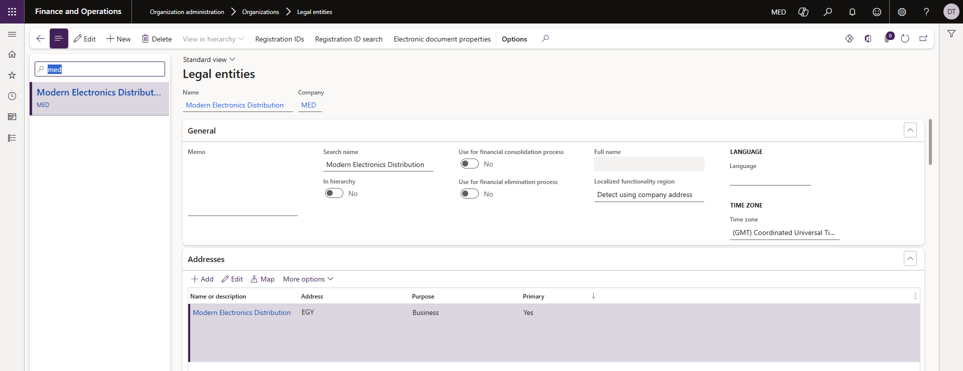
Company Financial Setup Legal entities The first step is to create a new Legal Entity containing the company name, country, and company data. Form path Organization administration>Organiztion>Legal entitites

Slide 7
General Ledger Setup Financial Setup
General Ledger
Chart of accounts
Financial dimensions
Fiscal calendars
Configure account structures
Currency exchange rates
Journal names

Slide 8
Charts of accounts
Process code | 01.01.01. Financial Management
Process name | Chart of accounts
Process description | Main account creation
Form path | General Ledger >> Chart of accounts >> accounts >> Chart of accounts

Slide 9
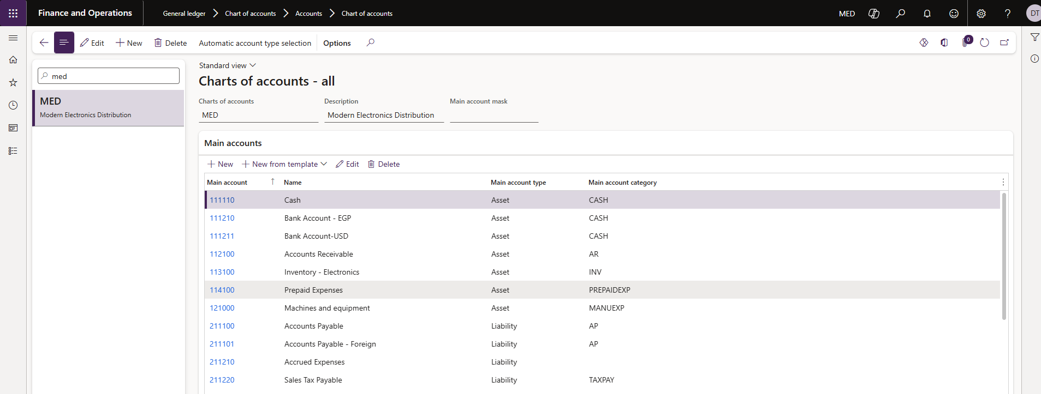
• Create the main accounts in the chart of accounts.

Slide 10
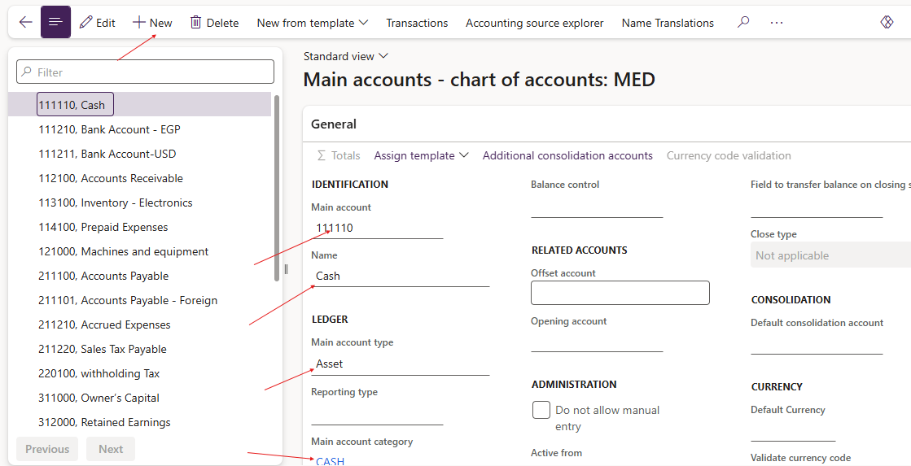
Clicking New will open the creation of the new account form.

Slide 11
Screen Information:
1. Enter an account number in the Main account field.
2. Enter an account Name in the Name field
3. Select the Main Account Type.
4. Select main account category.
5. Select the Do not allow entry check box if a user should not be manually entering this account in a journal entry. By selecting this check box, users are prevented from entering a value for this account.
6. Select the Default Currency in the Currency field.
7. Select the foreign currency revaluation check box if should can be used to revalue.

Slide 12
Financial Dimensions
Process code | 01.02.01. Financial Management
Process name | Financial Dimensions
Process description | Create financial Dimensions
Form path | General ledger >> Chart of account >> Dimensions >> Financial Dimensions

Slide 13
Financial Dimensions
The financial dimensions are used to:
Provide a more detailed description of a transaction.
Simplify the accounting process when you enable detailed analysis without the creation of a detailed Chart of Accounts.
Are defined to analyze and classify financial transactions as follows:
Financial transactions usually are organized according to voucher and account number.
Additional grouping and classification options are available when you assign several dimensions to transactions.
There are two types of financial dimensions:
Custom dimensions the values are entered and maintained by users such as branches.
Standard dimensions, the values are defined somewhere else in the system and automatically imported as dimensions, such as in Customers or vendors.

Slide 14
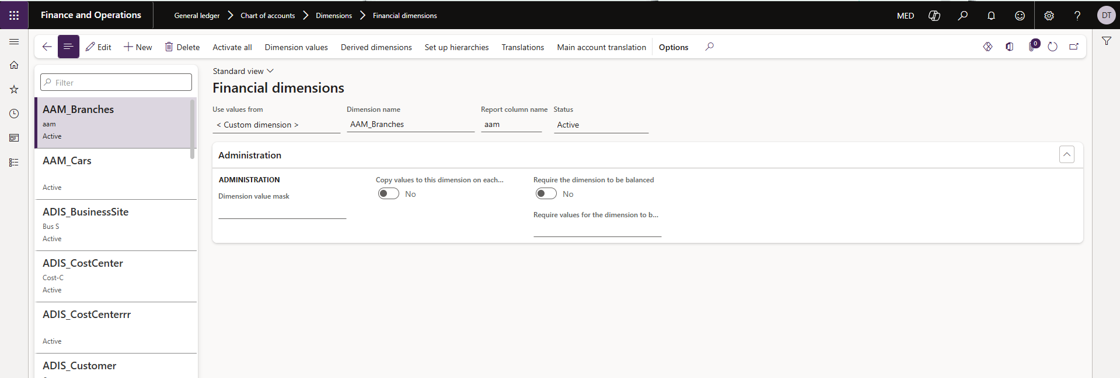
Financial Dimensions
Screen Information:
1- Click new
2- from Use values from: select < Custom dimension > or select specific financial dimension
3- Click on dimension values in case of Custom dimension.

Slide 15
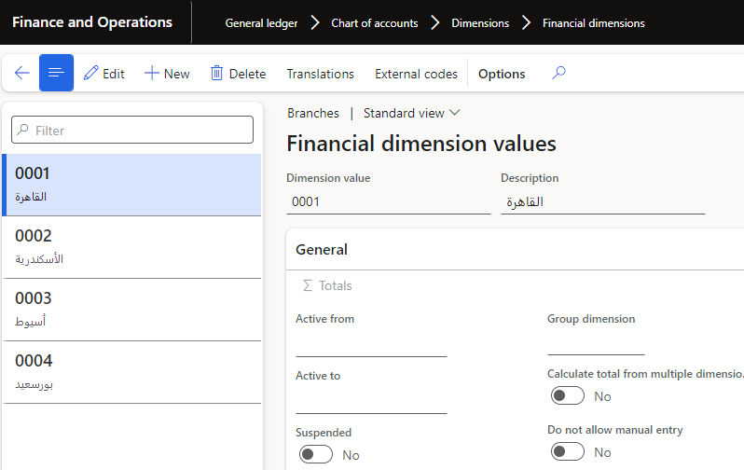
Financial dimensions
Screen Information:
1- Click new
2- From Dimension value: Enter dimensions code
3- From Description: Enter dimensions name

Slide 16
Fiscal Calendar
Process code | 01.01.02. Financial Management
Process name | Fiscal Calendar
Process description | Create Fiscal Calendar
Form path | General ledger >> Setup >> Fiscal Calendars

Slide 17
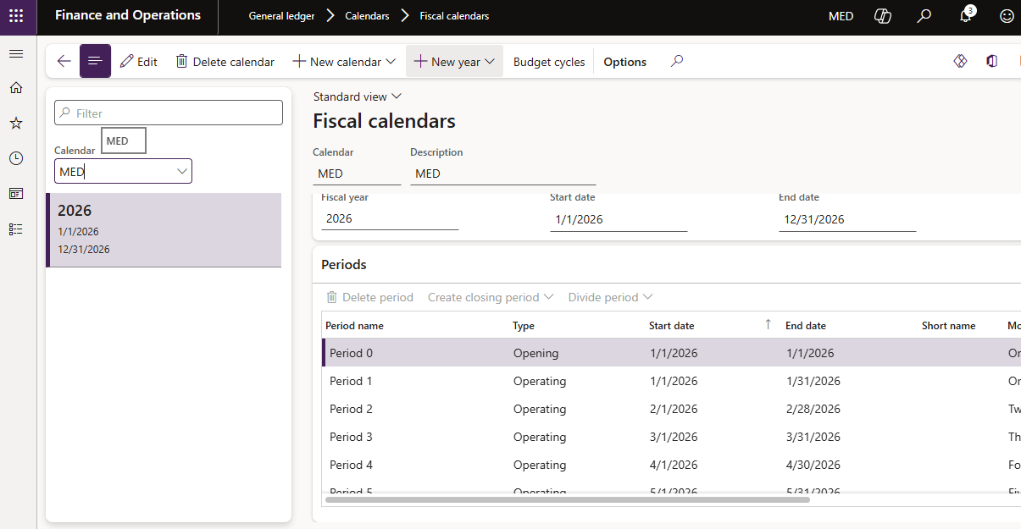
* We will create fiscal calendar start in 1/1 and end in 31/12

Slide 18
Screen Information:
Enter Fiscal Calendar name in the Calendar field.
Enter Fiscal Calendar description in the Description field.
In the Start of fiscal year field, enter the start date of the first Fiscal Year in the Calendar (1/1).
In the End of fiscal year field, enter the end date of the first Fiscal Year in the calendar.
Enter the name of the first Fiscal Year in the calendar in the Fiscal year name field.
In the Length of period field, enter 1.
In the Unit field, click the arrow to select Months.
8. Click the Create button to create the year.

Slide 19
Configure Account Structures.
Process code | 01.02.02. Financial Management
Process name | Configure account structures
Process description | Create account structures
Form path | General ledger >> Chart of accounts >> structures >> Configure account structures
Account structures use the main account and financial dimensions to create a set of rules that determine the order and values used when entering the account number.

Slide 20
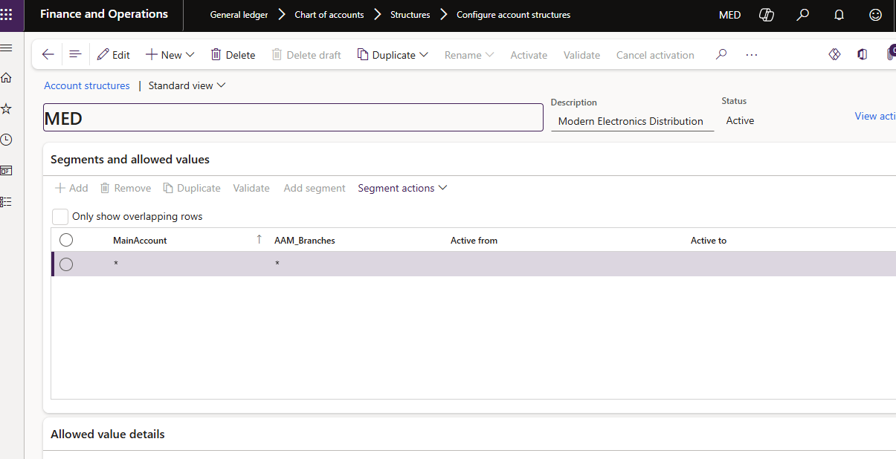
Configure account structures
Screen Information: 1- From Add segment we can add all financial dimensions we need 2- From Activate we can active the account structures Note: we can make any financial dimension mandatory or optional in accounting entries by using checkbox Blank values are allowed.

Slide 21
Currency Exchange Rate
Process code | 01.06.01. Financial Management
Process name | Currency exchange rates
Process description | Create exchange rates
Form path | General Ledger >> Currencies >> Currencies >> Currency exchange rates
* In Microsoft Dynamics 365, all currencies are provided by default and we will use the Egyptian pound as the functional currency.

Slide 22
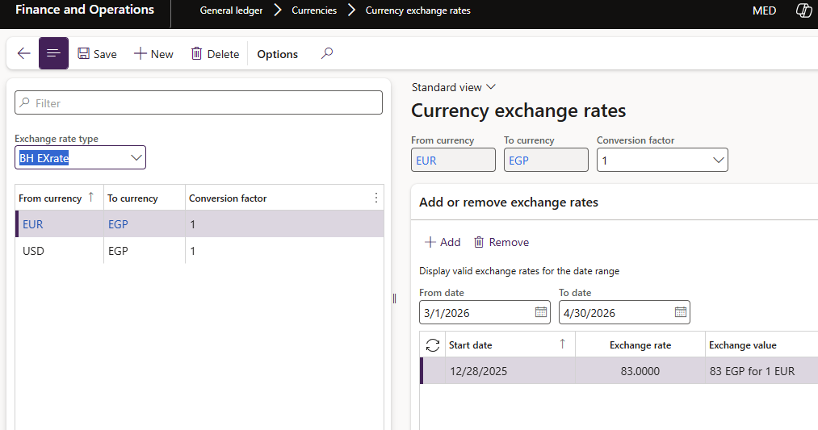
Currency Exchange Rate
Screen Information:
1. Click the New button.
2. Define the necessary exchange rates between a currency pair by selecting a currency in the from currency and the two currency drop-down list.
3. Define the start date and exchange rate, exchange value will be calculated automatically.

Slide 23
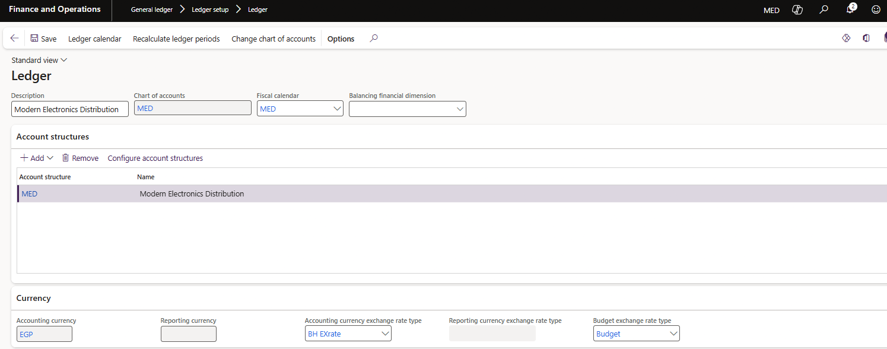
General ledger> Ledger setup> Ledger

Slide 24
Journal Names
Process code | 01.03.01. Financial Management
Process name | Journal names
Process description | Create Journal names
Form path | General Ledger >> Journals Setup >> Journal names

Slide 25
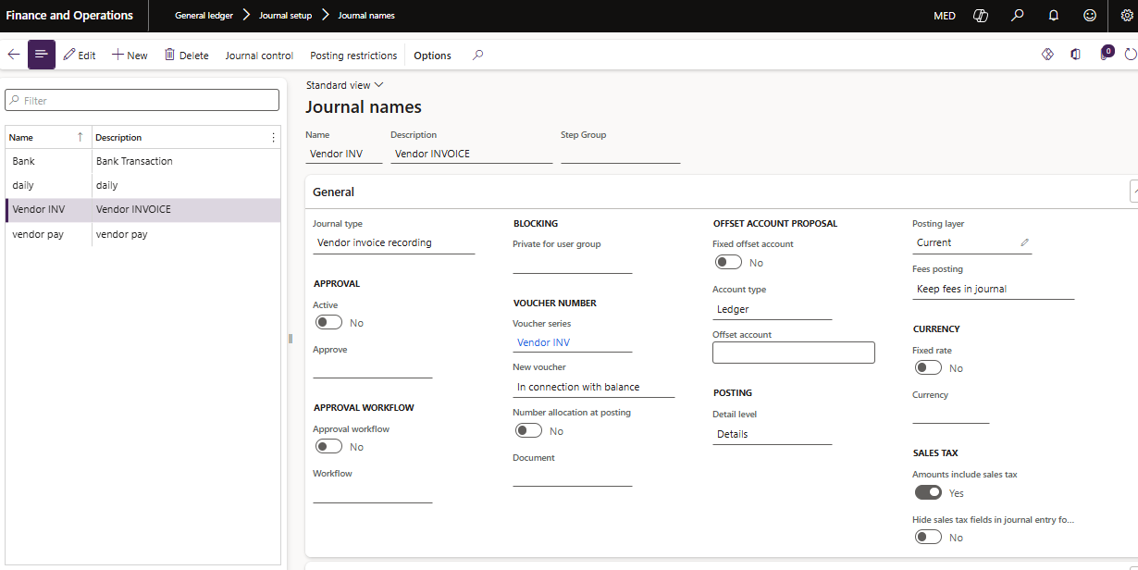
Journal Names
Screen Information:
1. Enter a recognizable journal name in the Name field.
2. Enter a description of the journal that clearly describes the purpose of the journal in the Description field.
3. Select the type of journal in the Journal type list. The journal type determines what the journal is used for and in which module it is available. For example, the customer payment Journal type is used only for customer payment journals.
4. Approval is to activate the approval of certain users on the journal transactions before posting.
5. Blocking is to allow only certain users to use this journal
6. Voucher series is the number sequence (serial) of the vouchers in the selected journal

Slide 26
Account Payable
Setup
Vendor Groups
Create New Vendors
Transaction
Invoice Journal
Methods Of Payment
Vendor Payment Journal
Vendor Posting Profile

Slide 27
Vendor Groups
Process code | 04.01.01. Financial Management
Process name | Vendor Groups
Process description | Vendor Groups
Form path | Accounts payable >> Vendors >> Vendor Groups
* Use vendor groups to set up certain information that always defaults when you enter a new vendor.
*For example, use the vendor group to set up automatic posting to General *Ledger accounts generated by vendor transactions.
*In the Vendor groups form, set up vendor groups. You must set up at least one vendor group, because a vendor group must be specified when you create a new vendor.

Slide 28
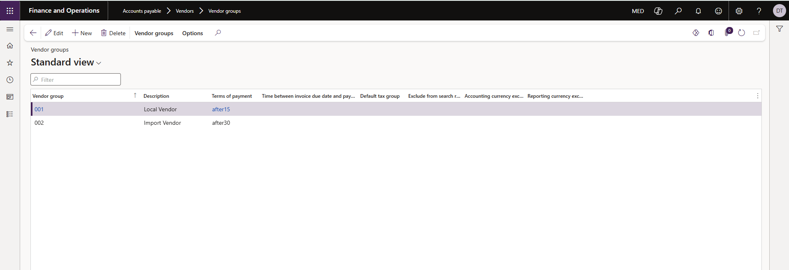
Vendor Groups
Screen Information
1. Click the New button to create a new record.
2. Enter a short name or code for the vendor group in the Vendor group field. This name is used throughout the system.
3. Enter the full name of the vendor group in the Description field.

Slide 29
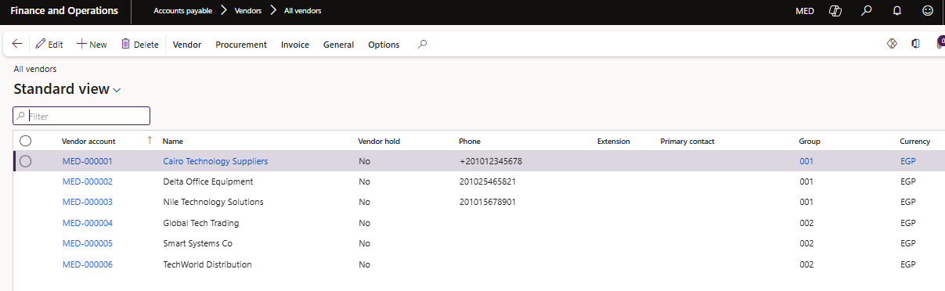
Create New Vendors
Process code | 04.01.02. Financial Management
Process name | Create New Vendor
Process description | Create New Vendors
Form path | Accounts payable > Vendors > All Vendors

Slide 30
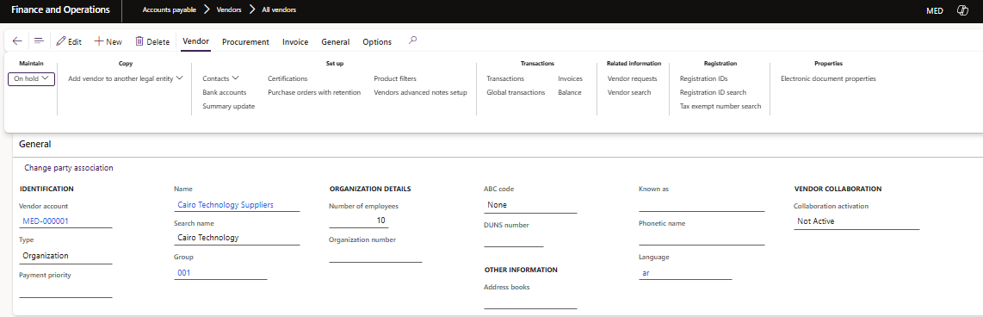
Create New Vendors
1- Click “New” to open the Vendor form for creation of new vendor.
Screen Information
1. Enter the Vendor ID with up to 10 characters in the Vendor account field application will generate it automatically.
2. Enter the vendor’s name with up to 30 characters in the Name field.
3. Select the vendor group to which the vendor belongs in the Group list.

Slide 31
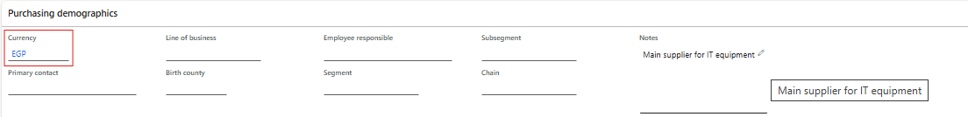
Create New Vendors
4. select the default vendor currency.

Slide 32
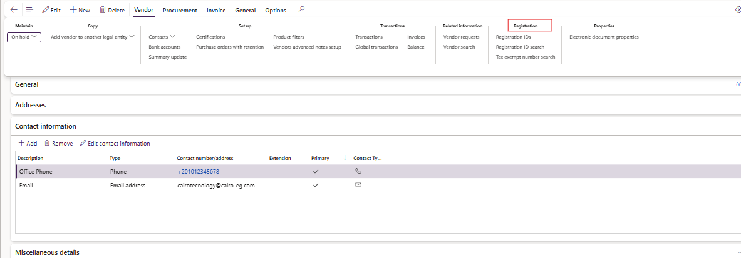
Create New Vendors
5. Enter the vendor's addresses on the Addresses Fast Tab.
6. click the registration ID

Slide 33
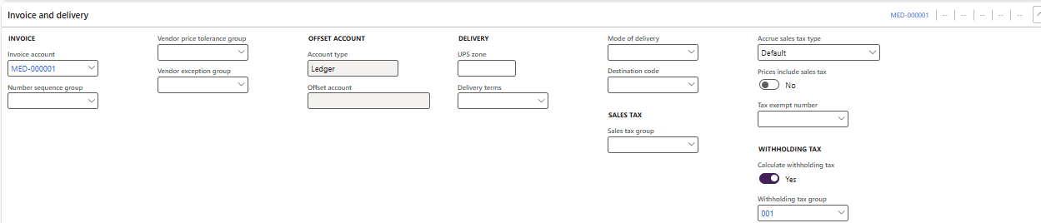
Create New Vendors
9-you can add invoice account which is more like parent-child relationship where finance side is owned by invoice account and order processing / fulfillment is done by order account. If left blank, then invoice account is same as vendor account.
10- You can set up a default tax profile ( Withholding tax & Sales tax) for a vendor. By default, the tax information is used when you create transactions for the customer or vendor. However, you can change the default information for individual transactions if you have to.
Note Withholding tax will not be calculated if the Calculate withholding tax checkbox is not switched on for this vendor.

Slide 34
Vendor Posting profiles
Process code | 04.01.03. Financial Management
Process name | Vendor Posting Profile
Process description | Vendor Posting Profile
Form path | Accounts payable > Setup > Vendor Posting Profiles
Vendor posting profiles enable you to assign general ledger accounts and document settings to all vendors, a group of vendors, or a single vendor.

Slide 35
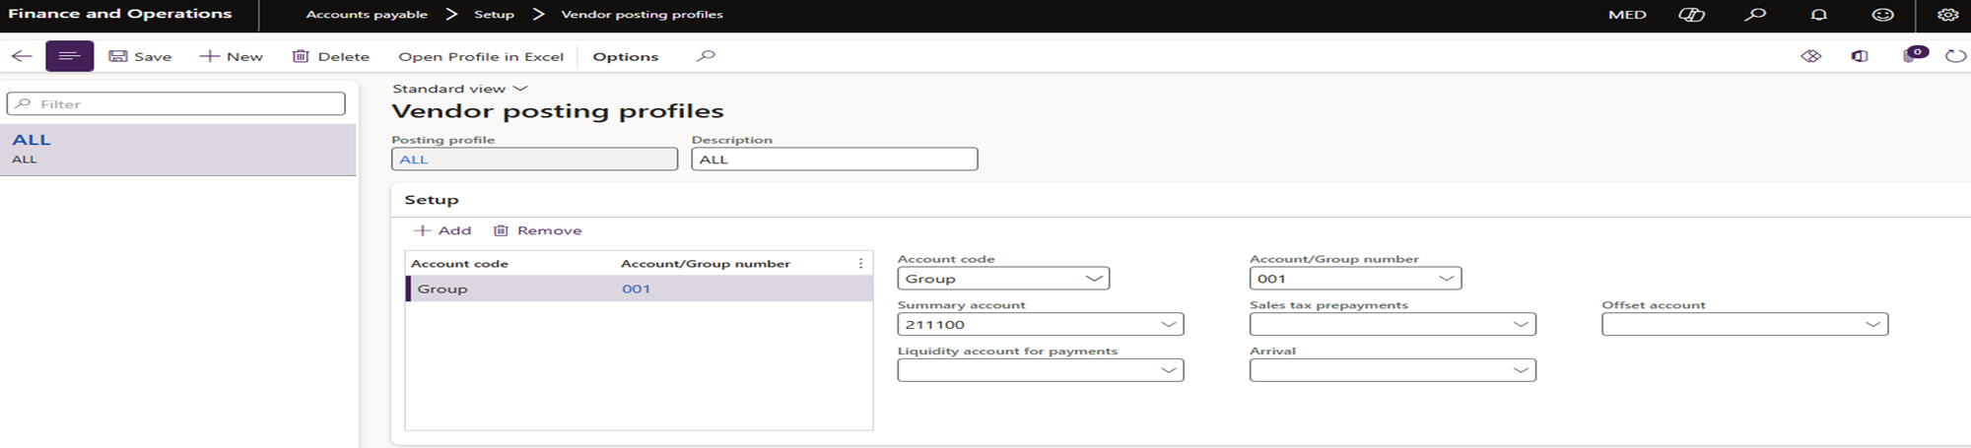
Vendor Posting profiles
Screen Information
1. Click the New button to create a new record.
2. Enter a code or a short name for the posting profile in the Posting profile field.
3. Enter a description of the posting profile in the Description field.
4. From the Vendor posting profiles form, click the Setup Fast Tab.
5. Click the Add button to add a new line.
6. Select an Account code:
Table
Group
All

Slide 36
Vendor Posting profiles
7. Specify which vendors belong to the current posting profile in the Account/Group number field.
If Table is selected in the Account code field, enter the account number of the vendor to whom the posting profile relates.
If Group is selected in the Account code field, enter the vendor group to which the posting profile relates.
If All is selected in the Account code field, do not fill in the field.
8. Select the account number of the ledger account that is used as the vendor summary account (Accounts Payable) for the vendor(s) to whom the posting profile relates in the Summary account field.

Slide 37
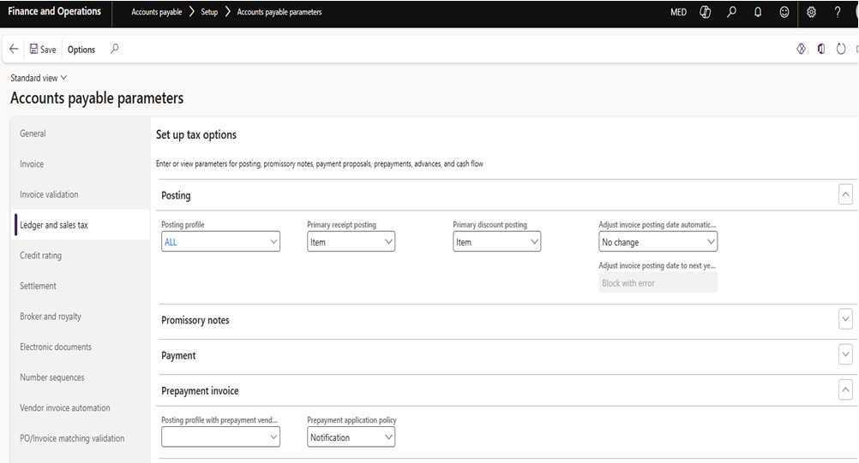
Accounts Payable Parameters
Form path
Accounts Payable → Setup → Accounts Payable Parameters
Explanation
Important settings for the Accounts Payable module were configured to control vendor transactions.

Slide 38
Methods of Payment
Process code | 04.03.01. Financial Management
Process name | Methods Of Payment
Process description | Methods Of Payment
Form path | Accounts payable > Payment Setup > methods of Payment
In the Methods of payment form, specify all the methods of payment the company uses to pay its vendors. For each method of payment, enter information that states how payments should be summarized and posted.

Slide 39
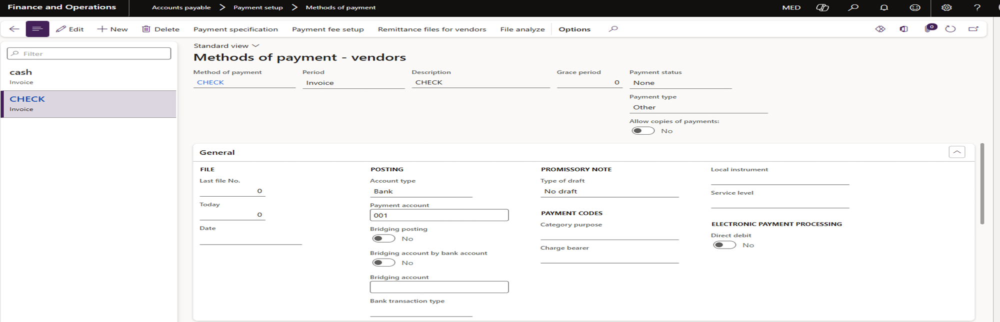
Methods of Payment
Screen Information
1- Click the New button to create a new record.
2- Enter a name for the new method of payment in the Method of payment field
3- Enter a description of the method of payment in the Description field.
4- Enter the Account Type (Ledger, Bank….) and the payment account for this method of payment.
5- incase of methods of payment checks active checkbox Bridging posting and select main account for Bridging account.

Slide 40
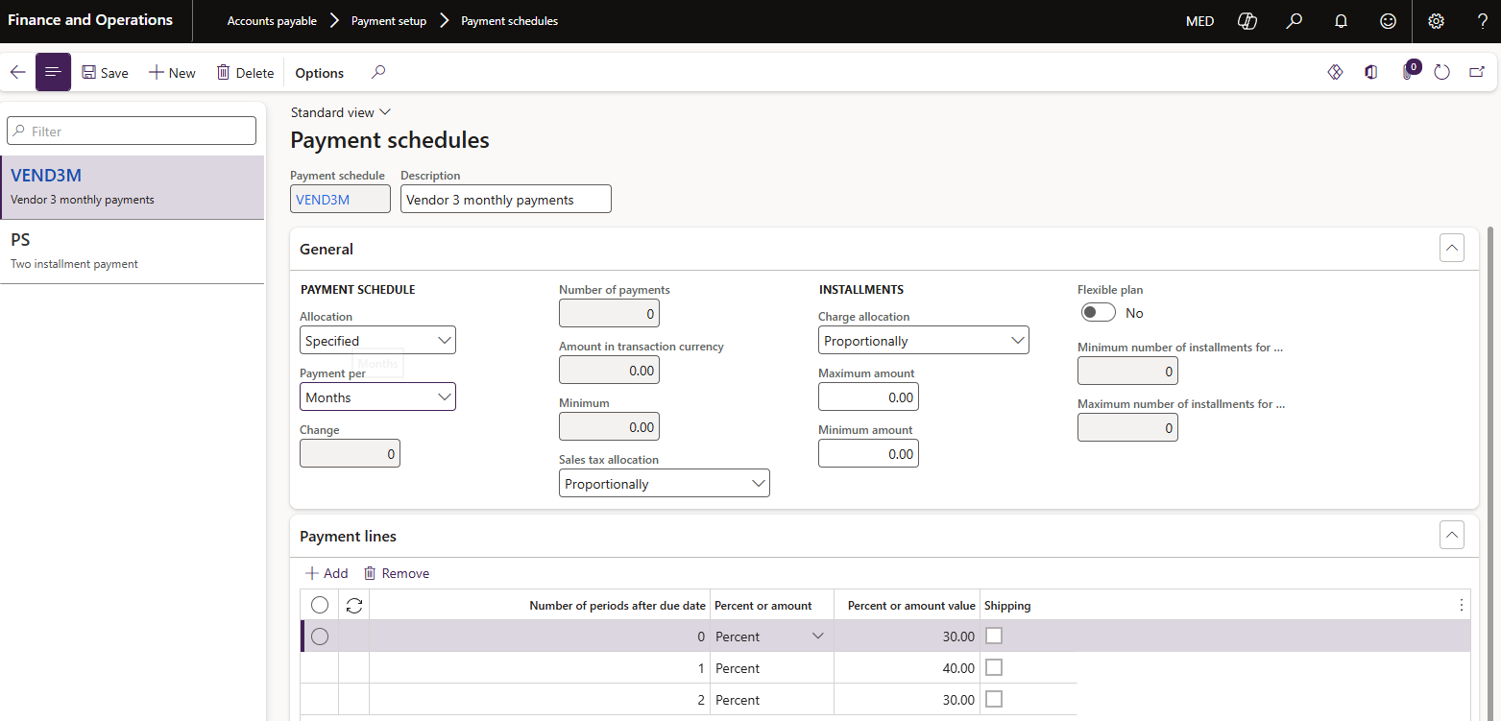
Payment Schedules
Form path
Accounts Payable → Setup → Payment schedules
A Payment Schedule is a feature used to split a total invoice or payable amount into multiple payments over time, instead of paying the full amount at once.

Slide 41
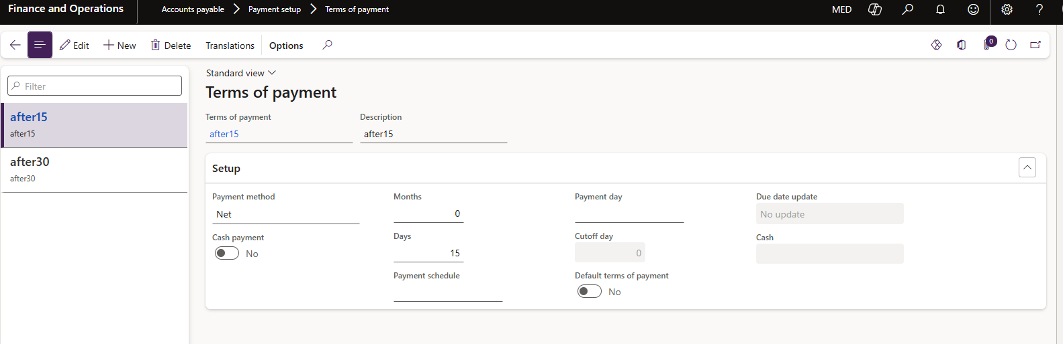
Payment Terms
Form path
Accounts Payable → Setup → Payment Terms
Explanation
Payment terms define when vendor invoices must be paid.
Examples created:
• Net 15
• Net 30

Slide 42
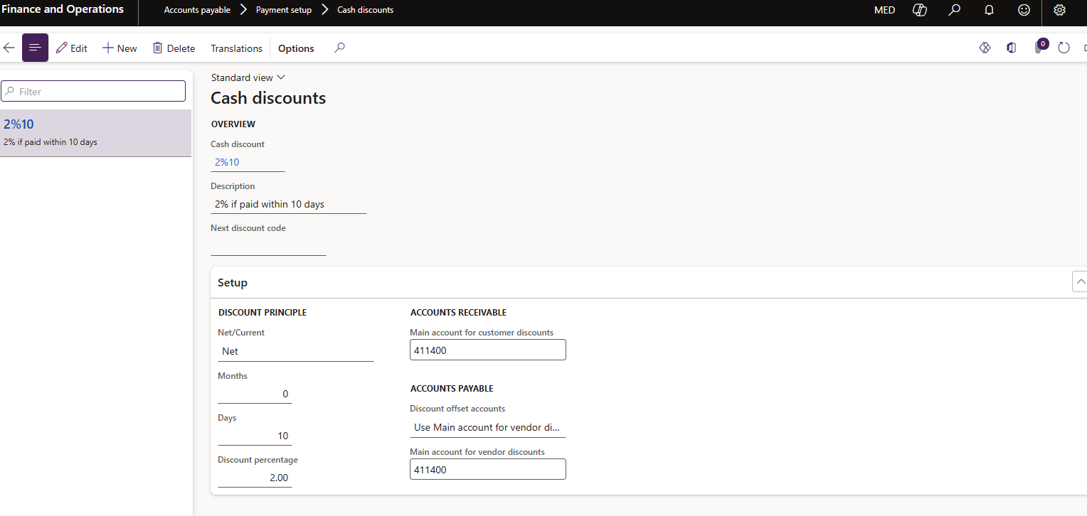
Cash Discounts
Form path
Accounts Payable → Setup → Cash Discounts
Explanation
Cash discounts were configured to allow early payment discounts.
Example:
2% discount if paid within 10 days.

Slide 43
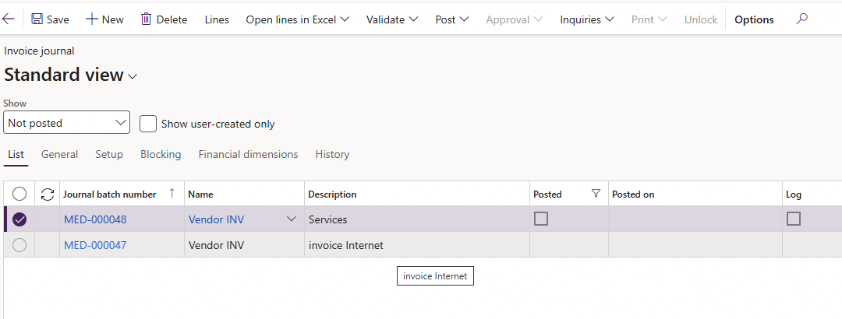
Invoice Journal
Process code | 04.02.02. Financial Management
Process name | Invoice Journal
Process description | Invoice Journal will be used to record the purchasing transactions of services
Form path | Accounts payable > Invoices> Invoice Journal
Click “New” and choose the invoice journal and enter the required description for the journal

Slide 44
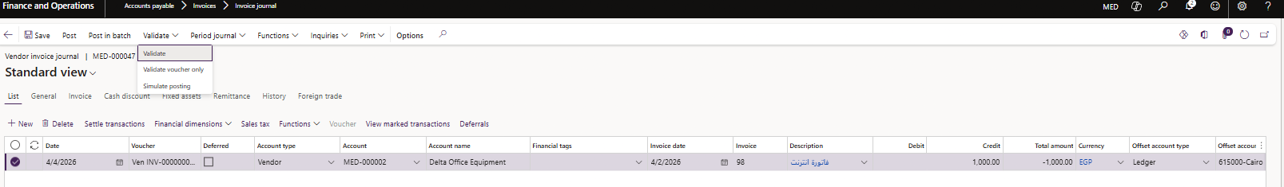
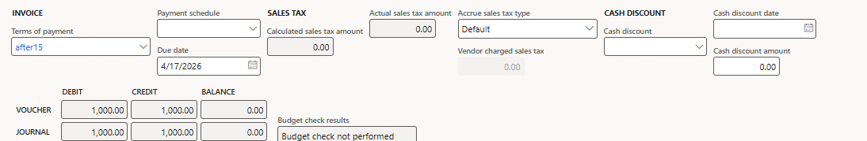
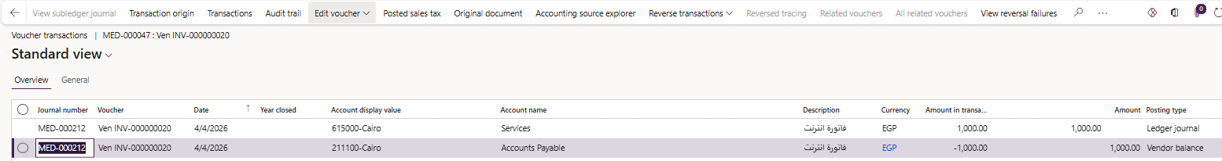
Invoice Journal
Click “Lines” to open the journal voucher screen to record the invoice.

Slide 45
Invoice Journal
Screen Information
1- Enter the posting date in the Date field. The system date displays, but you can change it.
2-The Voucher is entered automatically according to the number sequence attached to the journal.
3- Select the vendor to register the invoice of in the Account field.
4- Enter the invoice number in the Invoice field. You cannot post the invoice register if you do not specify an invoice number.
5- Select the description regarding the transaction in the Description field.
6- Enter the appropriate amount in the given currency Credit fields. Select the offset account type and account.
7- Select the currency.

Slide 46
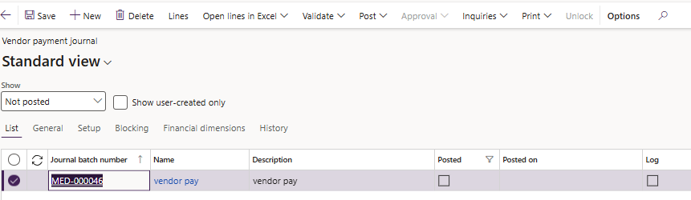
Payment Journal
Process code | 04.04.01. Financial Management
Process name | Payment Journal
Process description | Payment To vendor
Form path | Account payable > Payments > Payment Journals
1- Go to Accounts payable > Payments > Payment journal.
2- Click New to create a new payment journal.
3- Select journal name and enter Description.
4- Click lines to open the chosen journal and record the payment voucher.

Slide 47
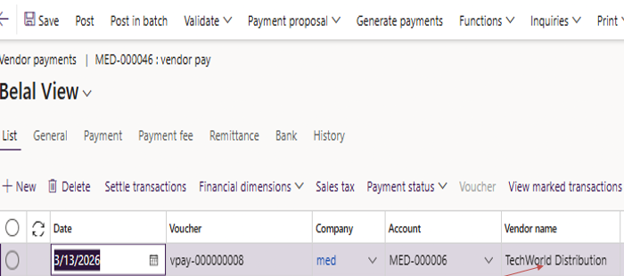
4- Invoices can be paid in full or partially through the payment vouchers.
5- The payment information can be manually filled or choose the vendor in the voucher and then choose “settle Transactions” and select the invoice that is needed to be paid, and the system will generate the information required to be filled.
6- This will open “Settle Open Transactions” screen from which to choose the invoice to be paid from the list of open invoices of the chosen vendor.

Slide 48
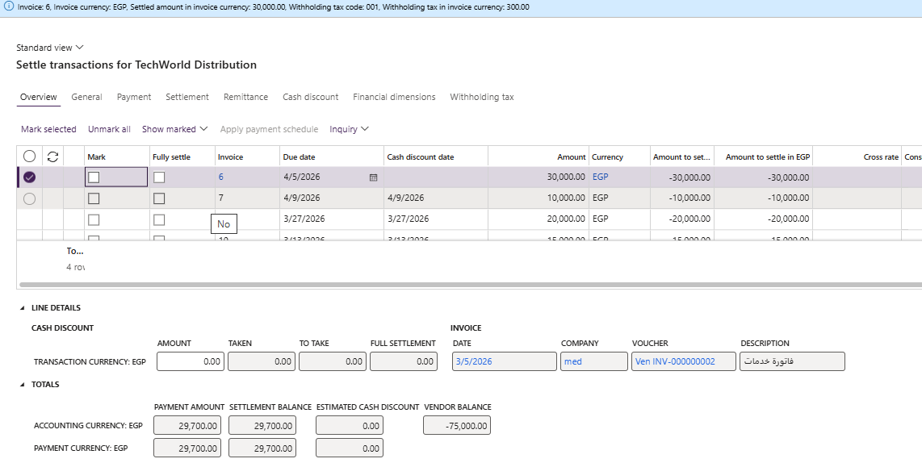
8- Check the box in the “Mark” column to choose the invoice or several invoices.
9- withholding tax will be automatically calculated if you set the Calculate withholding tax checkbox to Yes in the vendor card.

Slide 49
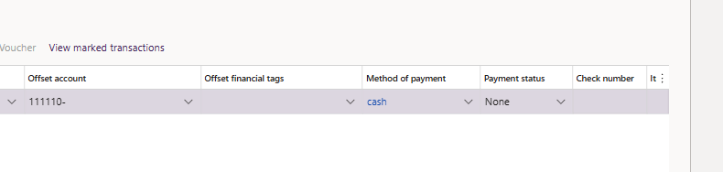
10- Then user can choose the method of payment or chose offset account and post.

Slide 50
Financial reports related to Vendor balances

Slide 51
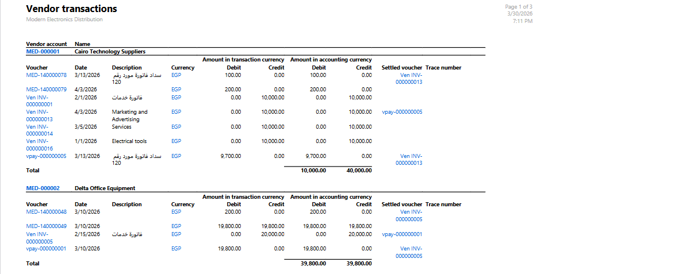
Vendor Transactions Report
Form path
Accounts Payable → Inquiries → Vendor transaction Description This report display all financial transactions redated to vendors within a specific period

Slide 52
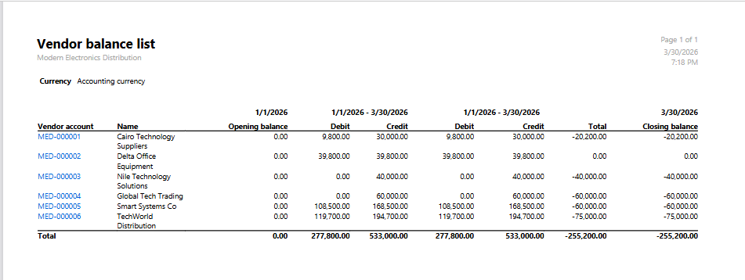
Vendor balance list
Form path
Accounts Payable → Inquiries → Vendor Balance Description This report shows the balance owed to each Vendor

Slide 53
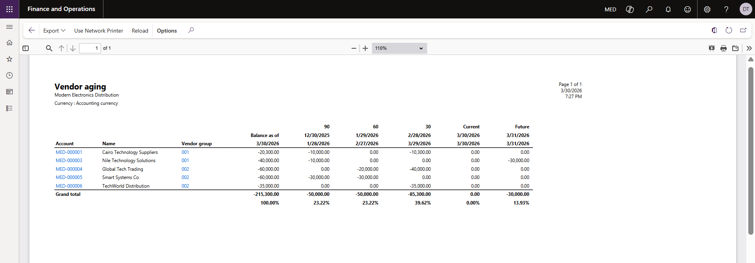
Vendor Aging Report
Form path
Accounts Payable → Inquiries → Vendor aging report Description Shows vendor aging balances classified based on aging periods

Slide 54
Conclusion
Project Summary: The Accounts Payable Implementation Project in Microsoft Dynamics 365 Finance successfully established a structured and automated AP process, covering vendor setup, invoice management, payment processing, and reporting.
Key Achievements:
Configured legal entities, vendor groups, and posting profiles for accurate financial transactions.
Streamlined invoice journals, settlement processes, and payment methods for operational efficiency.
Implemented payment schedules, terms of payment, and cash discounts to optimize cash flow.
Generated vendor reports and aging analysis to enhance monitoring and decision-making.
Benefits Realized:
Improved accuracy and consistency in vendor transactions.
Enhanced control and compliance with financial policies.
Increased efficiency in accounts payable processing.
Better visibility into outstanding liabilities and cash management.

Slide 55
Thank
You!

